Slide 1

Hive Spatial Analysis on Taxi-fare Dataset using ArcGIS tool
Group 5
Harsh Shah
Sushant Burde
Jeel Joshi
Shivani shah
DR. JONGWOOK WOO

Slide 2
Overview
Introduction
Dataset Overview
Cluster Overview
Big Data
Hive
Workflow
Analysis
Visualization
GitHub Link
References

Slide 3
Introduction
With the rapid growth in Cab industry, increasing profit by reducing cost and fuel becomes a key factor.
Providing taxi services on prime areas and saving fuel are the prime source for increasing market growth and saving money.

Slide 4
In our analysis, We predicted some of the prime locations and unnecessary fuel consumption happened while taxi ride.
Geographical parameters is the essential key for analyzing any spatial data.
Providing right information to taxi industry is our primary goal to increase profit.

Slide 5
Dataset Overview
https://www.kaggle.com/alvaroibrain/my-attempt-to-nyc-taxi-fare-prediction/data
Considered Regions : New York region, United States
File Size: 2.5 GB
File Format: CSV (Coma Separated Values)

Slide 6

Cluster Overview
Version: Apache Ambari - 2.6.2.2
Total Nodes: 6
OS: Centos 7 (x86-64)
Disk Size: 269.66 GB/3666.45 GB
Disk Usage: 7.35% used
CPU: 16 vCPU
CPU Speed: Avg 600 ms
Memory: 31.16 GB/120 GB

Slide 7

Big Data
Big data is a PROBLEM. To SOLVE the problem Hadoop is the solution.
Hadoop technologies and initiatives are growing to analyze this data for gaining insights that can help in making strategic decisions.

Slide 8

Hive
Apache Hive is an open source data warehouse system for querying and analyzing large data sets that are principally stored in Hadoop files
Hive is commonly a part of compatible tools deployed as part of the software ecosystem based on the Hadoop framework for handling large data sets in a distributed computing environment

Slide 9
Initially Hive was developed by Facebook, later the Apache Software Foundation took it up and developed it further
It converts SQL-like queries into MapReduce jobs for easy execution and processing of extremely large volumes of data
It is familiar, fast, scalable, and extensible

Slide 10
Workflow
Visualize the data using Distance, fare amount and Fuel Consumption
Categories to demo the availability of rides in specific locations
Insert external jar files for Spatial Analysis
e.g. st_point,
st_linestring
Load Dataset into Linux Environment
Analyze the dataset and use spatial function to extract Geographical Attributes
e.g. Distance
Analyze Structure of the dataset and remove null and duplicate values
Tableau and ArcGIS tool
Preformed Categorization by using few columns,
e.g. Fare amount & Distance
Fuel Consumption Categories
Filter data by unique key and store into the table using Hive Metastore
Showcase the result of visualization and determine insights

Slide 11
Analysis
Data Cleaning
Data Cleaning refers to the process of removing invalid data points from a dataset.
Data cleansing is a valuable process that can help companies save time and increase their efficiency.
Remove all the rows from the train table which contain o value.

Slide 12
Spatial Function
A spatial query is a special type of database query supported by geodatabases and spatial databases.
Two of the most important are that they allow for the use of geometry data types such as points, lines and polygons and that these queries consider the spatial relationship between these geometries.

Slide 13
While typical databases have developed to manage various numeric and character types of data, such databases require additional functionality to process spatial data types efficiently, and developers have often added geometry or feature data types.
In addition to typical SQL queries such as SELECT statements, spatial databases can perform a wide variety of spatial operations.

Slide 14
Spatial Measurements: Computes line length, polygon area, the distance between geometries, etc.
Spatial Functions: Modify existing features to create new ones, for example by providing a buffer around them, intersecting features, etc.
Geometry Constructors: Creates new geometries, usually by specifying the vertices (points or nodes) which define the shape.
Observer Functions: Queries which return specific information about a feature such as the location of the center of a circle

Slide 15
Spatial Queries
ST_Point
create temporary function ST_Point as ‘com.esri.hadoop.hive.ST_Point';
create function st_point as 'com.esri.hadoop.hive.ST_Point' using jar hdfs:///user/sburde/spatial-sdkhadoop.jar';.

Slide 16
ST_LineString
create temporary function ST_LineString as 'com.esri.hadoop.hive.ST_LineString';
create function st_linestring as 'com.esri.hadoop.hive.ST_LineString' using jar hdfs:///user/sburde/spatialsdk-hadoop.jar';
ST_Length
create temporary function ST_Length as com.esri.hadoop.hive.ST_Length';
create function st_length as 'com.esri.hadoop.hive.ST_Length' using jar 'hdfs:///user/sburde/spatial-sdkhadoop.jar';

Slide 17
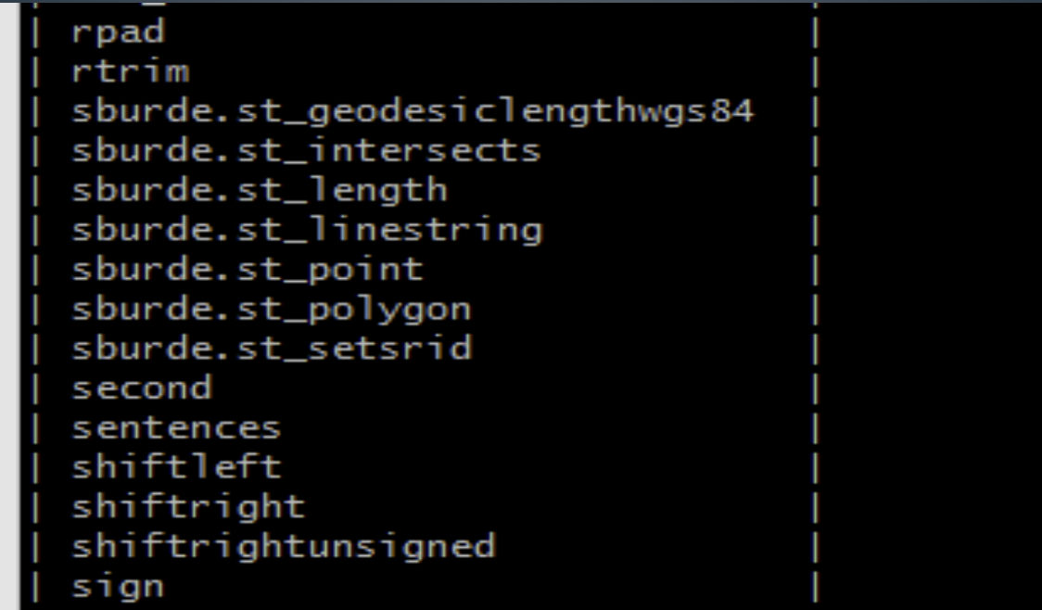
External Jar Files

Slide 18
Measuring Distance
To get the line from Longitude and Latitude
To get the line from Longitude and Latitude
To get the line from Longitude and Latitude
To get the line from Longitude and Latitude
To get the line from Longitude and Latitude

Slide 19
Distance Calculation
Calculate the Distance travelled per trip using st_linestring function.
To get the line from longitude and lattitude
select id, pickup_datetime,st_linestring(pickup_longitude,pickup_latitude,dropoff_longitude,dropoff_latitude) Line from train_rides limit 10;
To get the Distance
select id, pickup_datetime, st_geodesiclengthwgs84(st_setSRID(Line, 4326)) Distance from (select key, pickup_datetime, st_linestring(pickup_longitude,pickup_latitude,dropoff_longitude,dropoff_latitude) Line from train_rides) Sub limit 10;

Slide 20
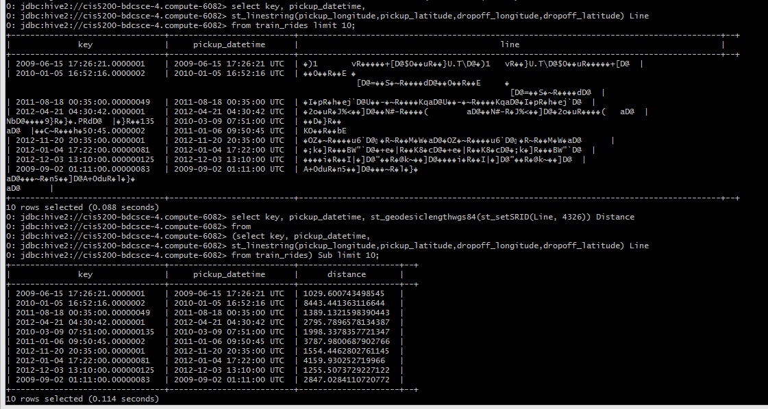

Slide 21

Fuel consumption categories
By using fare amount and distance, we calculated fuel consumption.
$Fuel Consumption=distance÷(10 ∗ fare_amount$)
Categories by High fuel, Normal fuel and Less fuel consumption.
More than 35– HIGH
Between 25 to 35(Inclusive) – NORMAL
Less than 25 - LESS

Slide 22
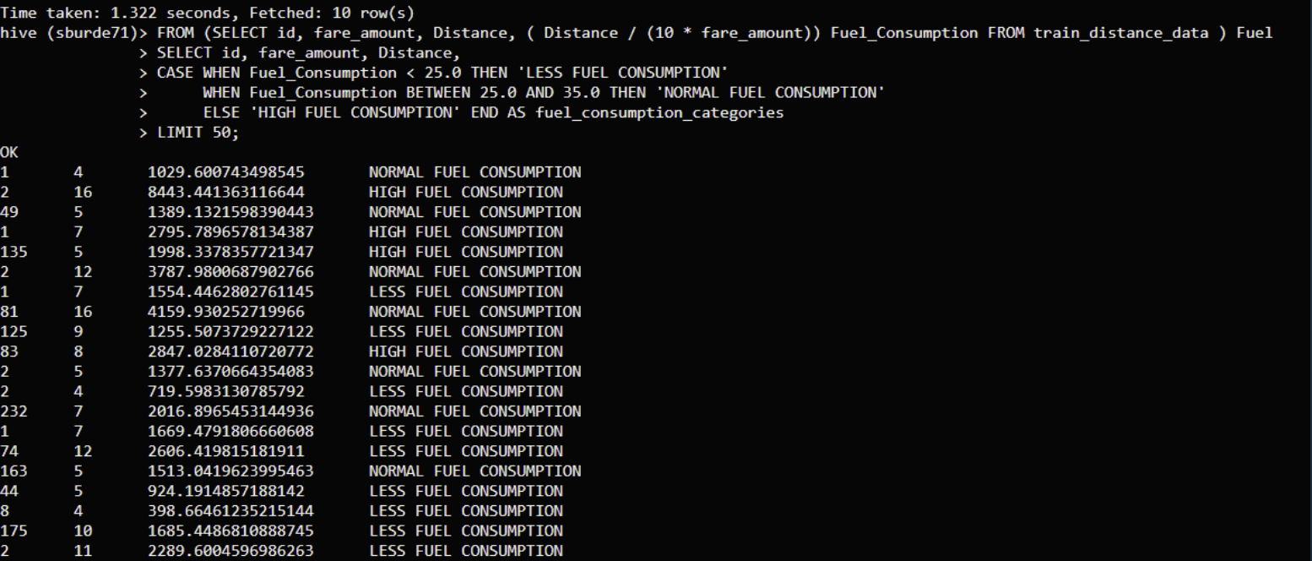

Slide 23
Visualization
ArcGIS tool:
ArcGIS is a geographic information system (GIS) for working with maps and geographic information.
It is used for creating and using maps, compiling geographic data, analyzing mapped information, sharing and discovering geographic information, using maps and geographic information in a range of applications, and managing geographic information in a database.

Slide 24
Tableau
Tableau is a powerful business intelligence and data visualization tool that has a very intuitive user interface. You don’t need any coding knowledge to work with Tableau. It is very useful in drilling-down data, creating insightful reports and garner actionable business insights.

Slide 25
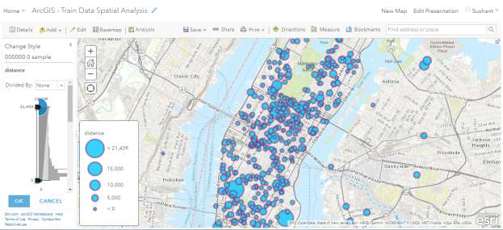
Distance parameter to showcase the volume of availability in various regions as shown below.

Slide 26
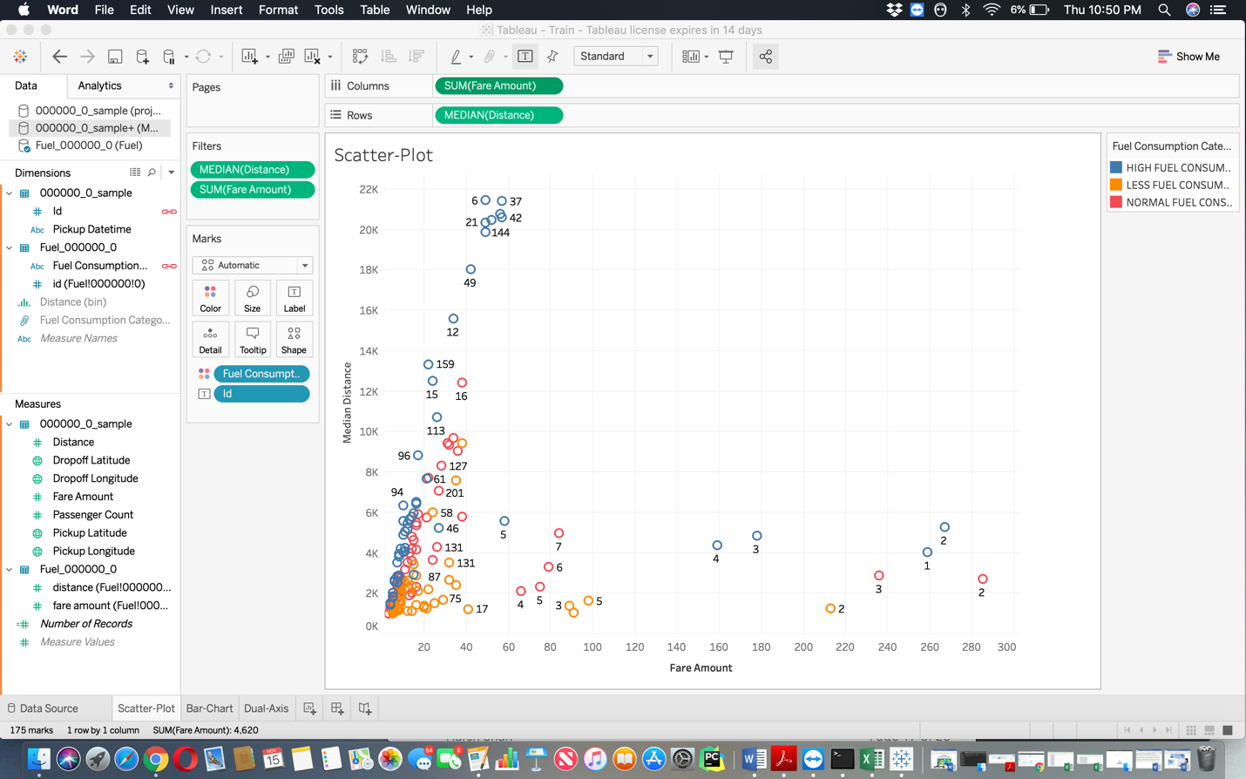
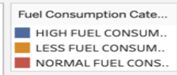
Fuel consumption of the Taxies by using the distance travelled by Taxi

Slide 27
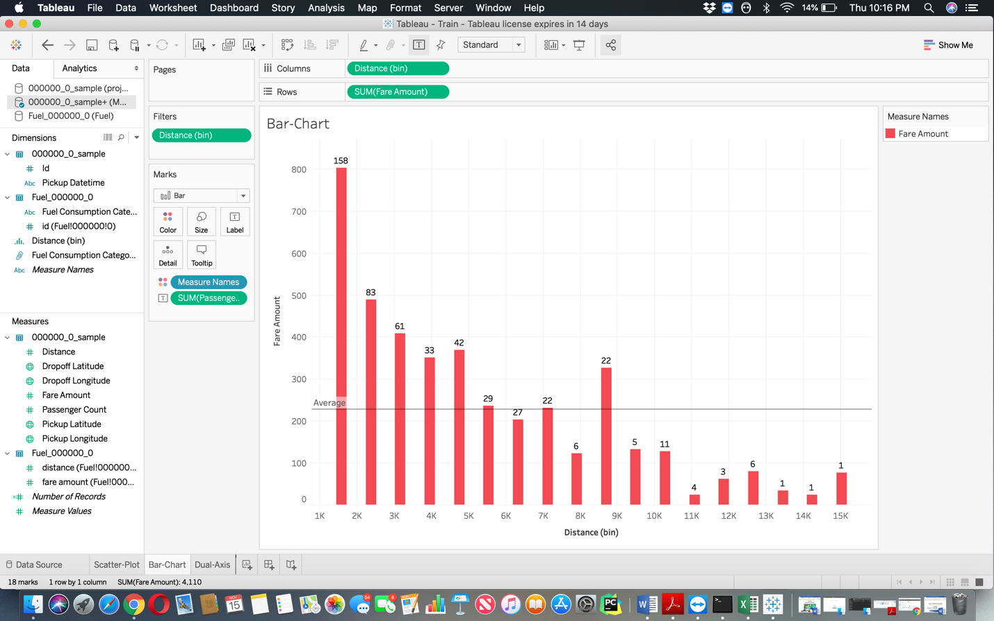

Give the average Fare Amount by the passenger count

Slide 28
Github Link
https://github.com/sburde71/Spatial_Analysis_Train_Dataset

Slide 29
References
[1] Huiyu Sun ; Suzanne McIntosh ,“Big Data Mobile Services for New York City Taxi Riders and Drivers,” IEEE Xplore, 19 December 2016
[2]https://github.com/sburde71/Spatial_Analysis_Train_Dataset
[3] Umang Patel, “NYC Taxi Trip and Fare Data Analytics using Big Data,” 2014
[4] https://www.slideshare.net/mobile/hortonworks/hive-meetup-spatial-1
[5] Sunghwan Cho, “ORANGE : Spatial big data analysis platform,” Korea.
[6]https://www.academia.edu/7626053/Big_Data_Spatial_Analytics_An_Introduction
[7] Canserina Kurnia, “Big Data and Analytics with ArcGIS”, Esri Global Asia Pacific
[8] https://www.oraylis.de/blog/geo-spatial-data-support-for-hive
[9]https://docs.oracle.com/cd/E83740_01/BDSPA/hive-spatial-functions.htm#BDSPA-GUID-FFEED52D-AAA0-4251-9BB8-5F49D0A887B9
[10] https://towardsdatascience.com/how-taxis-arrive-at-fares-predicting-new-york-city-yellow-cab-fares-71a8c43b7c50

Slide 30
ANY Questions.
???

Slide 31
Thank you!!

